Slide 1
IMAGE PROCESSING
WEEK-1

Slide 2
4. ML to classify an image

Slide 3

What is image classification :
Image classification is the process of taking an image or picture and getting a computer to automatically classify it ,or try providing the probability of the class of the image.
Use cases :
Organize the photos on phones gallery by friends,family,etc.
In radiology it is used to find anomalies in x-rays.
In self-driving cars to identify object around us.
Challenges:
  Change in viewport.

Slide 4
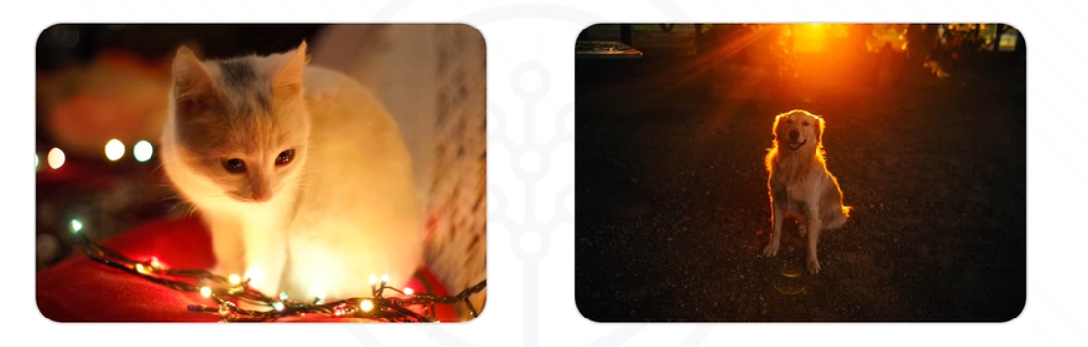
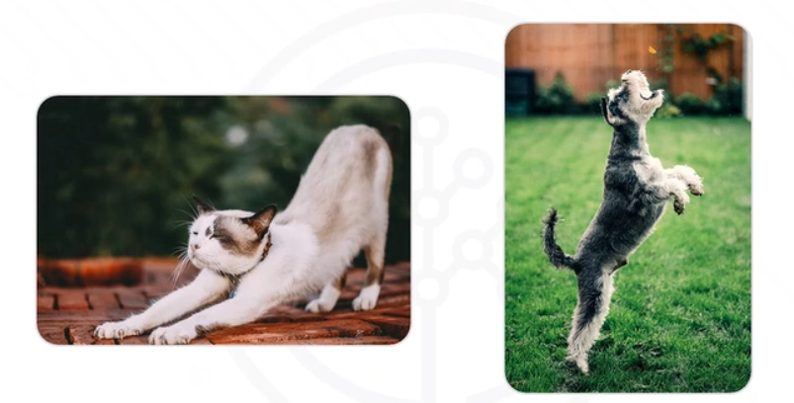
Change in illumination .
Change in deformation .

Slide 5
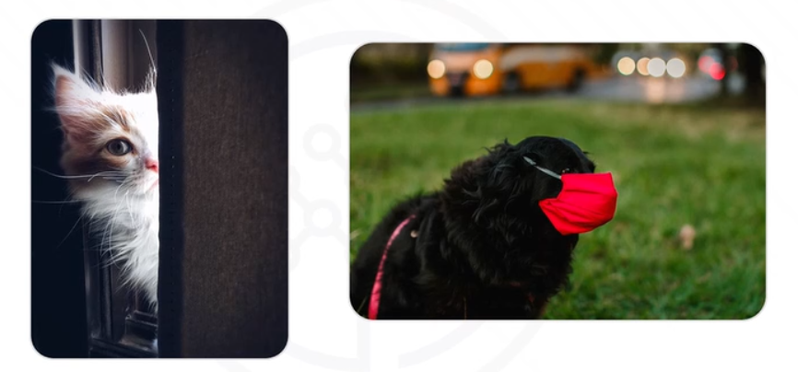
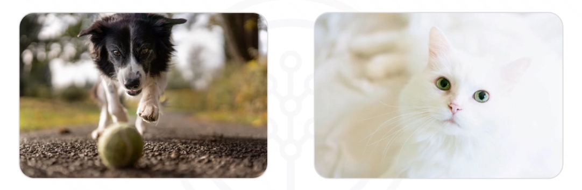
Change in occlusion .
Background clutter .

Slide 6
Image classification with KNN :
KNN :
KNN stands for k-nearest neighbours.
It is the simplest classification algorithm
It classifies the unknown element by most common class and find the nearest points to the class.
It calculates the common points by calculating the euclidean distance between 2 points.
Working :
  It works by calculating the distance between each point present in the classes and the unknown element
  The unknown element gets the label of the class with which it had the smallest distance.
KNN is not used for multiclass classification , knn works slows while dealing with multiple classes.

Slide 7
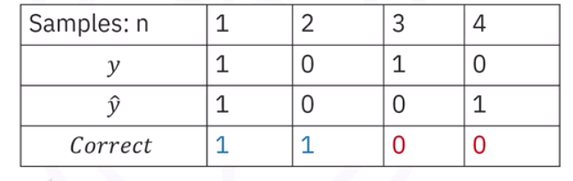
Training and testing set:
Separation of the dataset into training and testing set is an important part of model evaluation.
Out of 100% of dataset :
  70%,60%,or 80% of the data is used as training set to train the model
  20%,30% or 40% of the data is used as testing set to test the model on new data.
Accuracy :
Accuracy is determine how good the model works.
Accuracy is determined by calculating the number of times model predicted data correctly.
1- dogs in the dataset
0- cats in the dataset
Y - actual class
y^ - predicted class

Slide 8
Feature extraction techniques:
HOG -> Histogram of oriented gradients:
Captures edges directions and object shape
HOG captures
Shapes
Human silhouettes
Object boundaries
Working:
Compute pixel gradients
Divide image into small cells
Build histograms of edge directions in each cell
Normalize them in blocks
Combine all histogram
Widely used in pedestrian detection

Slide 9
SIFT- Scale invariant feature transform
It is used for :
Extracts key points that are stable under : scale changes, rotation , illumination changes.
Working :
Detect important points
Compute orientation around each point
Create a 128-d descriptor
Use these descriptors for matching or classification
benefits:
Works well even when the images are resized or rotated.

Slide 10
SURF - Speeded up robust features
It is an faster version of SIFT
Working :
Uses box filters and integral images for speed
Still scale and rotation invariant
Produces describes like SIFT but faster
Use cases:
Object matching ,tracking

Slide 11
LBP - Local Binary Patterns:
Captures textures information
Working :
Compare it with its 8 neighbours.
If neighbor>=center ->then “1”,else”0”
From an 8-bit binary number
Convert to decimal , and build histogram of all LBP values
Use case:
Face recognition , texture analysis

Slide 12
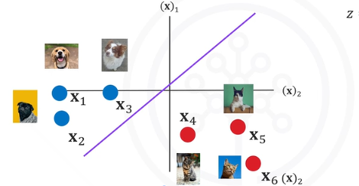
Linear classifiers :
Linear classifier is the most simplest and widely used models in machine learning.
It is used for predicting the class of the data point by computing the weighted sum of its features and applying decision rules
It makes decision as : if f(x)>0 ->class 1 or else class 0
Linear classifiers works by separating the classes by using a straight line.
Advantage :
  Fast and easy to train
  Works well with high dimensional data
  Give great accuracy when the data is linearly separable.
Disadvantage :
  Cannot model complex nonlinear patterns
  Performs poorly if classes overlaps in nonlinearly. way.

Slide 13

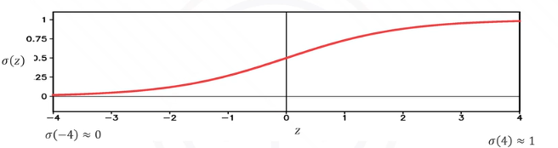
Logistic regression :
Logistic regression is type of linear classifier that uses sigmoid function to convert the output to probability.
Logistic functions works best for binary classification.
Sigmoid function :
If the value of z is very large negative then the expression is approximately zero.
- If the value of z is very large positive then the expression is approximately one.
Everything in middle has value between 1 and 0.
Can make multiple decision boundary and has to select the best decision boundary for classification

Slide 14
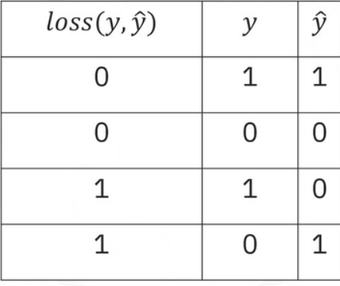
Loss function:
  The function determines how good your prediction is .
  Every time your prediction is correct => 0
  Every time your prediction is incorrect => 1
Cost function: classification error:
  Cost function yells how good our learnable parameters are doing on the dataset.
  The loss increase the cost .
  Cost is the sum of loss and cost is related to decision boundary the better the decision boundary is cost is going to be 0.

Slide 15
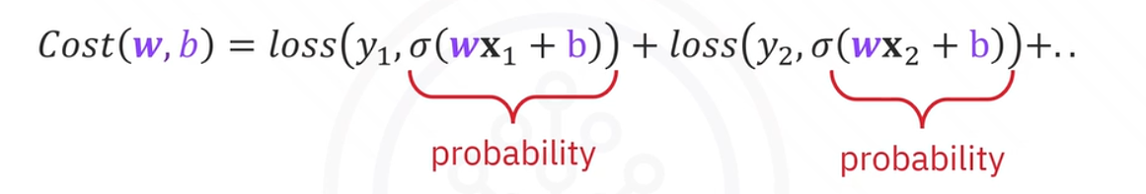
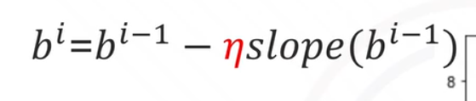
Cross entropy:
  Cross-entropy deals with how likely the image is going to be in a specific class.
  If likelihood of belonging to a particular class incorrect is large then cross entropy will be large.
  If likelihood of belonging to a particular class correct then cross entropy will be small but not zero.
Gradient descent :
  Gradient descent is a method to find the minimum of the cost function.
  Formulae :
b^i = updated parameter at current iteration i.
b^i-1 = parameter value of the previous iteration
Eta is the learning rate-> a hyper parameter that controls the size of steps taken
When gradient becomes zero ,the parameter stops updating.

Slide 16
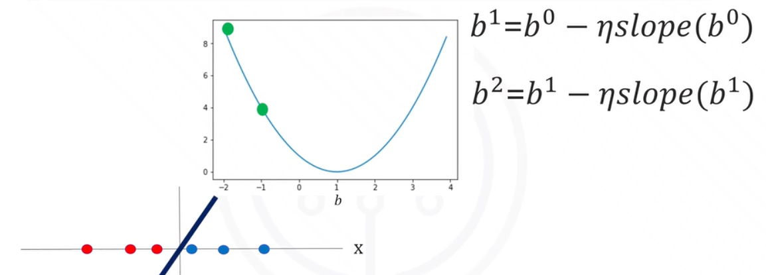
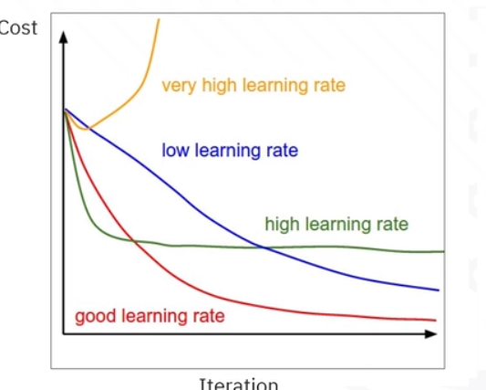
Learning curves =>

Slide 17
Mini-batch gradient descent :
In mini-batch gradient descent we divide the dataset into small batches
For each batch we can calculate the loss, compute the gradient and update the model weights.
When we use all the samples in the dataset we call it as an epoch.
It’s called batch gradient descent where one iteration is equal to one epoch.
Epoch :\
  Epoch means one complete pass of the entire training dataset through model
  Example - reading a book :
    One epoch => reading a whole book once
    Multiple epochs means reading the book many times so the model can learn well.
  Advantages :
    Reduces loss
    Adjust weights better
    Improve accuracy
In one epoch we can have multiple batchs

Slide 18
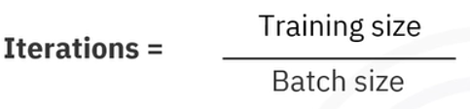
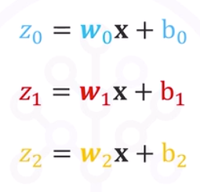
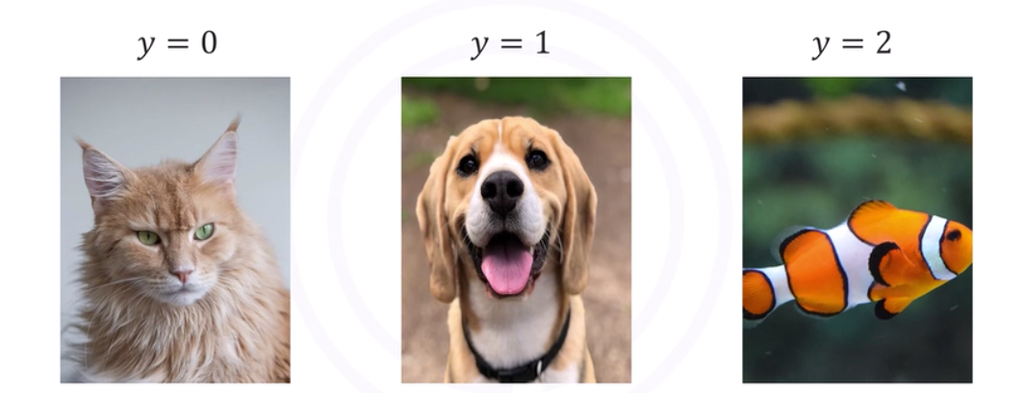
No of iterations :
Softmax and multi-class classification :
Argmax function :
  Argmax function returns the index of largest value in sequence of numbers.
Softmax is a simple linear classifier used for multiclass classification(more than 2 classes)

Slide 19
Sometimes the softmax function is not the best option .
Advantages of softmax :
  It is simple and fast
  Works well with multi-class classification
  Used in CNN final layers
  Used for text,images classification tasks.
Disadvantage of softmax :
  Only learn linear values
  Sensitive to outliers
  Poor performance in high-dimensional data
  Assumes classes are mutually exclusive

Slide 20
Classical ML Classifiers:
SVM - support vector machine:
Helps in finding best separating hyperplane between classes.
Need ?:
Works well with high-dimensional feature like HOG
Use kernels to classify non-linear patterns
Output:
Binary or multi-class prediction
Random forest:
It is an ensemble of many decision trees
Each tree give a vote -> majority decides output
Strengths:
Handles noisy data
Robust
Works well when combined with texture-based features.

Slide 21
KNN - k-nearest neighbors:
It computes the prediction by :
Compute distance to all the training samples
Pick k nearest ones
Majority label becomes output
Pros :
Very simple , no real training phase
Cons:
Slow during prediction , sensitive to noisy features

Slide 22
Why classical ML fails compared to deep learning:
Deep learning(CNNs) has replaced classical ML for several reasons:
Manual feature engineering:
Classical ml need - HOG,SIFT,LBP,color features,etc and are designs by humans. But CNNs learn features automatically
Not robust to variations:
Traditional ML fails with : different lighting,background clutter,rotations,scaling.CNNs handle these naturally.
Shallow representations:
classical ML extracts low-level feature only,CNN extracts hierarchical features: low-level->edges,mid-level->corners,textures,high-level -> object concepts
Cannot handle large datasets:
traditional ml is memory expensive. Deep prediction scales perfectly with GPUs and large data.
Lower accuracy :
Modern accuracy architectures outperform classical ML by huge margins.

Slide 23
POC -
Cat vs Dog classification using HOG+SVM
https://colab.research.google.com/drive/1nydnGhFaF9PMRkem3e2B0MPwu5TNDbi3#scrollTo=nTZQfyT-yglN
Real-time webcam classification
https://colab.research.google.com/drive/1CMkeK6cf0Zl4MrG0sm0UtXW_Q2bicQBc

